Slide 1
CSE 373 Optional Section Union Find, Homework 4
2013-10-31 & 2013-11-05
A. Conrad Nied

Slide 2
Agenda
Candy
Interview Question
Geopolitical Union Find
Homework 4

Slide 3
Interview Question
Social network connectivity. Given a social network containing N members and a log file containing M timestamps at which times pairs of members formed friendships, design an algorithm to determine the earliest time at which all members are connected (i.e., every member is a friend of a friend of a friend … of a friend). Assume that the log file is sorted by timestamp and that friendship is an equivalence relation. The running time of your algorithm should be MlogN or better and use extra space proportional to N.

Slide 4
Interview Question 2
How can I test if a singly-linked list is a palindrome?

Slide 5
Geopolitical Union Find
http://www.youtube.com/watch?v=NvQtIusaEqM&list=PLOzUGhfPlMJzUf9_yqnNWKuNUjlTK0YCv&index=1

Slide 6
Homework 4
What numbers do we care about?
How many rooms are in the maze?
Height or Number of Rows
Width or Number of Columns
How many interior walls
How many exterior walls
What are dimensions of any 2D collections?

Slide 7
Homework 4
By the numbers
For a maze with 4 rows and 5 columns:
20 total rooms
49 walls
31 interior walls
16 vertical interior walls (4 x 4)
15 horizontal interior walls (3 x 5)

Slide 8
Homework 4
By the numbers
For a maze with 3 rows and 7 columns:
21 total rooms
52 walls
32 interior walls
18 vertical interior walls (3 x 6)
14 horizontal interior walls (2 x 7)

Slide 9
Homework 4
What data structures do we want?
A UnionFind array that has each room’s set
Something to keep track of walls
Recommendation:
Have two arrays, one for vertical and one for horizontal

Slide 10
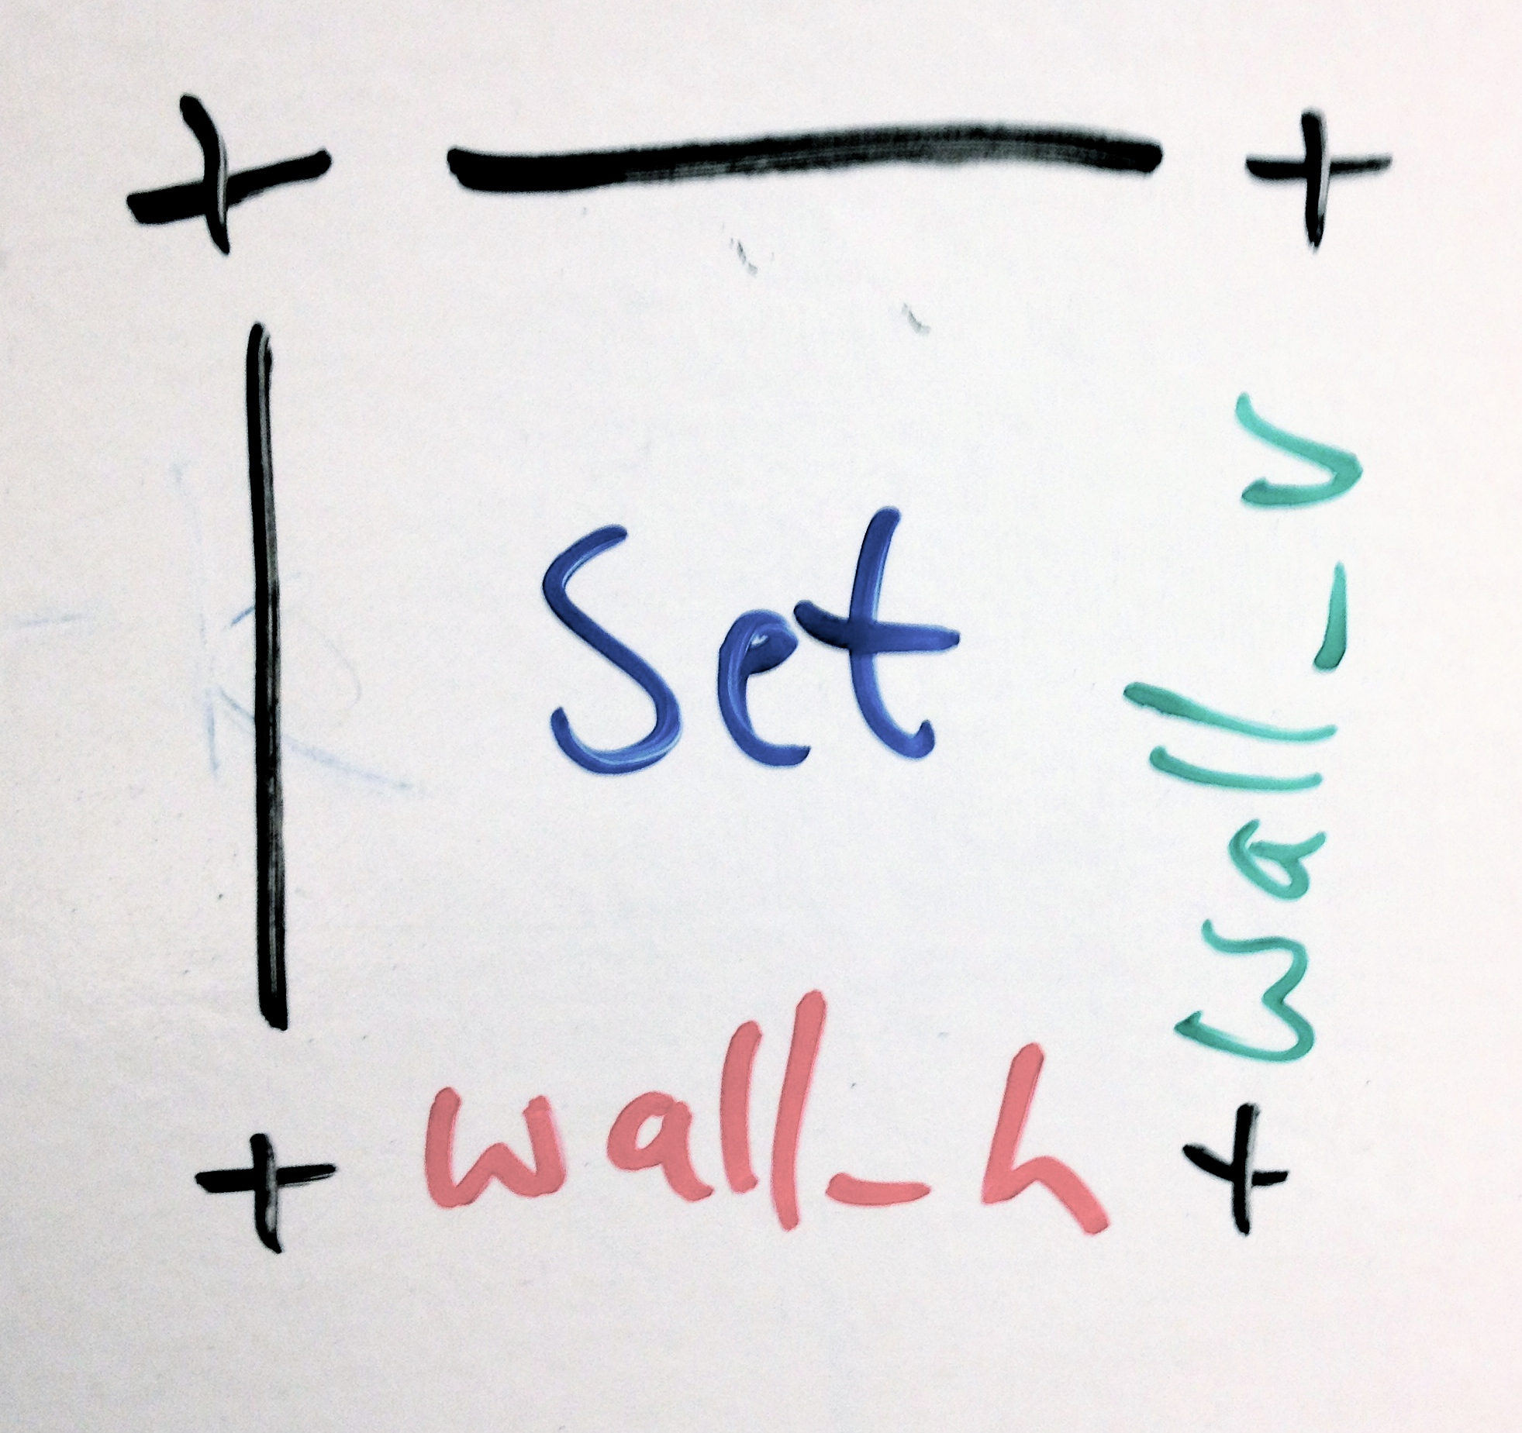
Homework 4
How to visualize the selection.
Each room is responsible for knowing its set and its walls left of and below it.

Slide 11
Homework 4
Thereby for a maze (height = 3, width = 4):

Slide 12
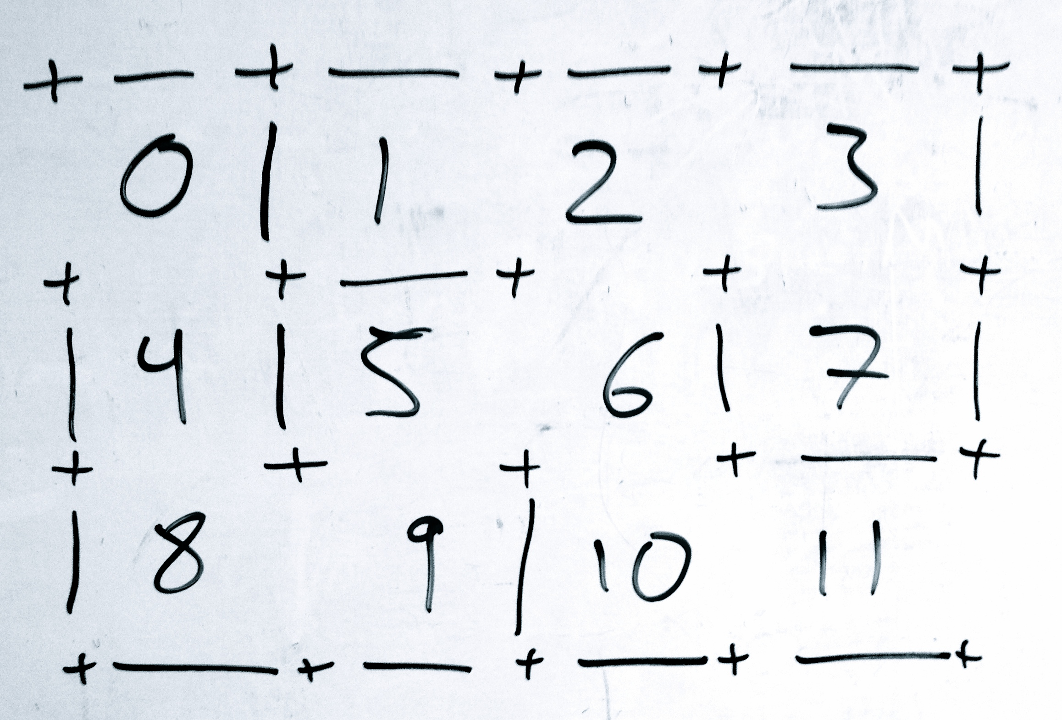
Homework 4
The rooms are numbered like this:

Slide 13
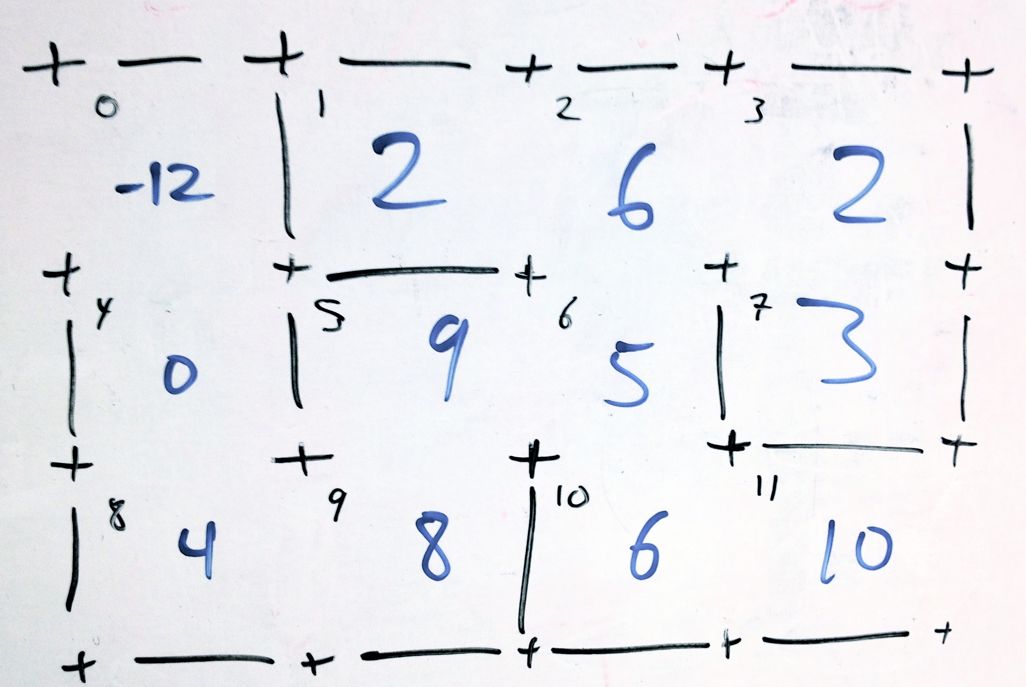
Homework 4
After uniting all of the nodes, the UnionFind array looks like this:

Slide 14
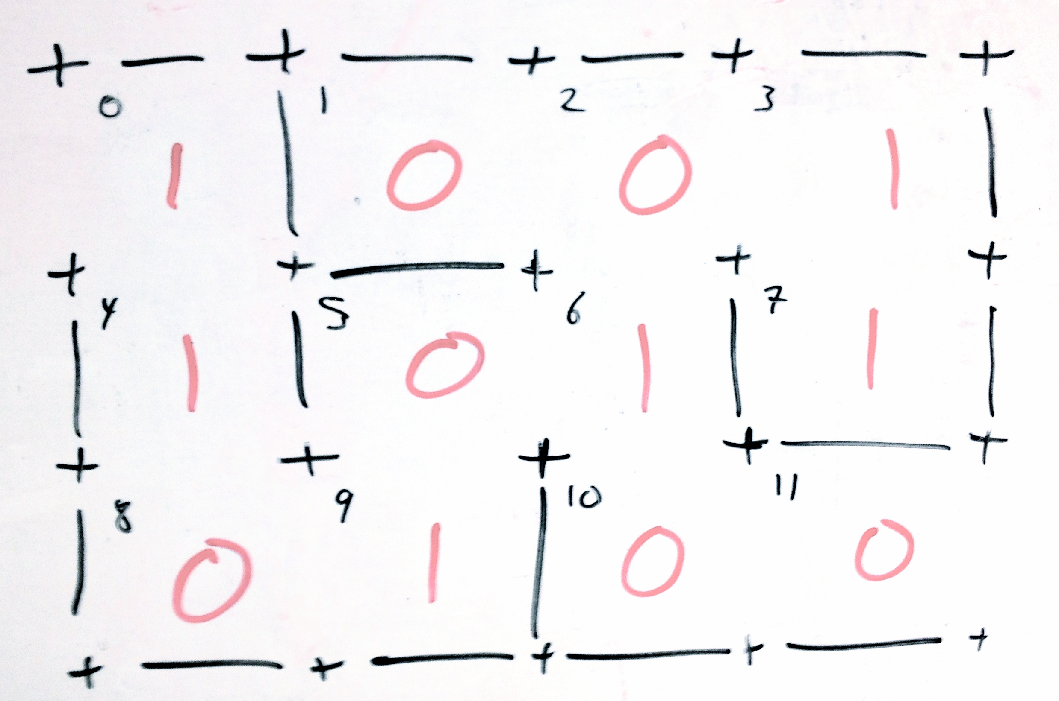
Homework 4
The walls to the left of each room are valued as such (1 means that the wall is in the maze)

Slide 15
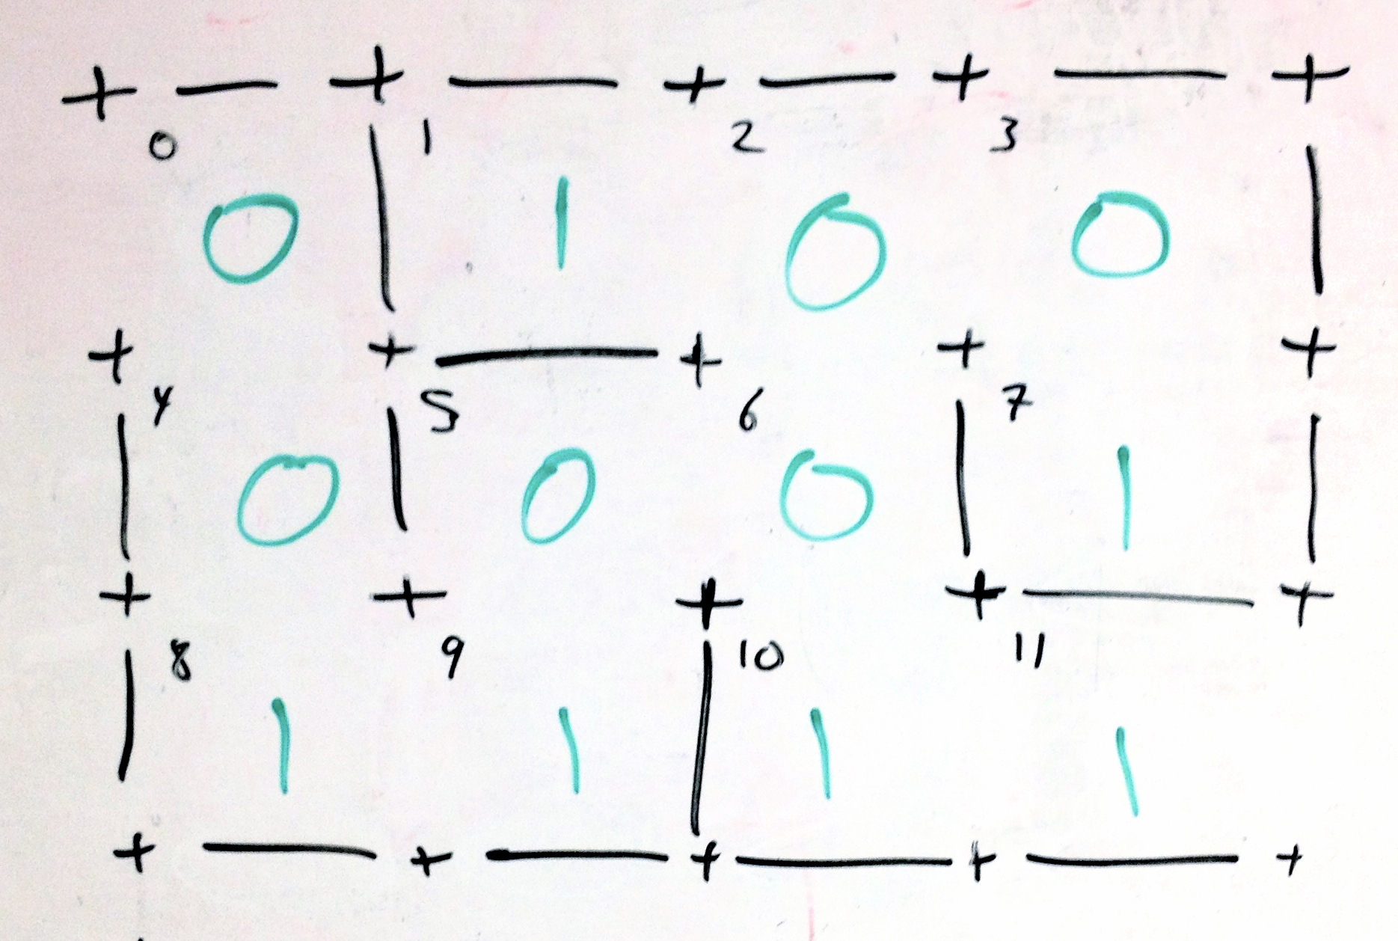
Homework 4
Likewise, for the horizontal walls below each room:

Slide 16
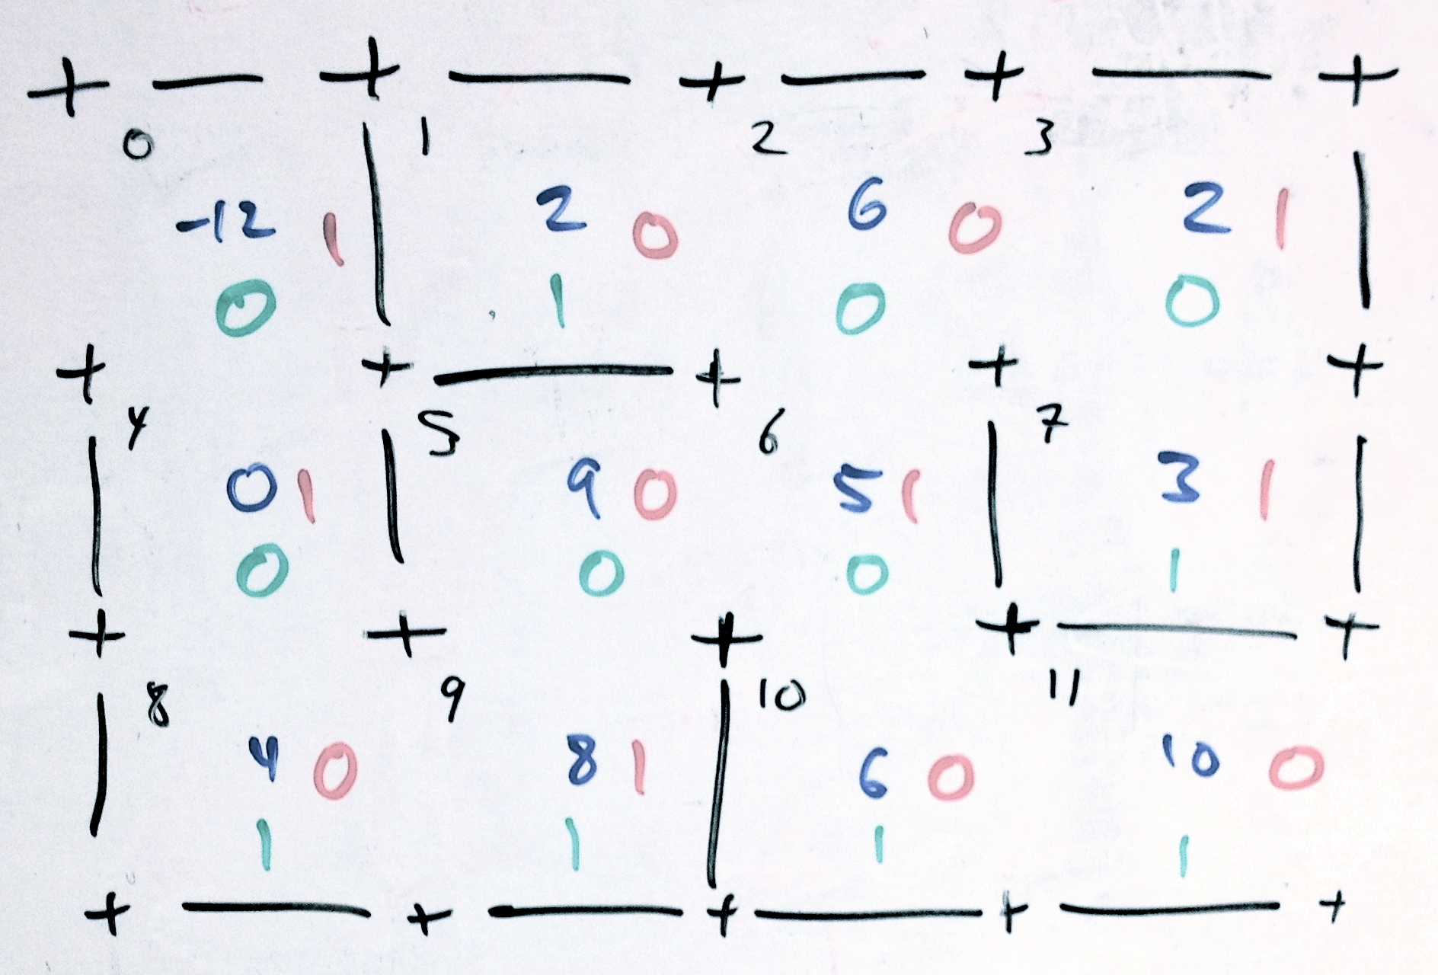
Homework 4
All together, the numbers for the rooms and the walls look like this:

Slide 17
Homework 4
With 3 arrays that look like this:

Slide 18
Homework 4
Now that you have your data structures you want to make your mazes!
Find walls to remove
Find at random, rooms, walls, and/or neighbors
Make sure you want to remove it
Its neighbors are disjoint but adjacent
Its not exterior
Remove it, mark it in your array for vertical or horizontal walls arrays, and check if you should continue removing walls

Slide 19
Homework 4
To show your mazes:
Make the top row of walls
For each row
Make a row of rooms and vertical walls
Make a row of horizontal walls below this row of rooms
Make sure that you have an opening at the entrance and exit

Slide 20
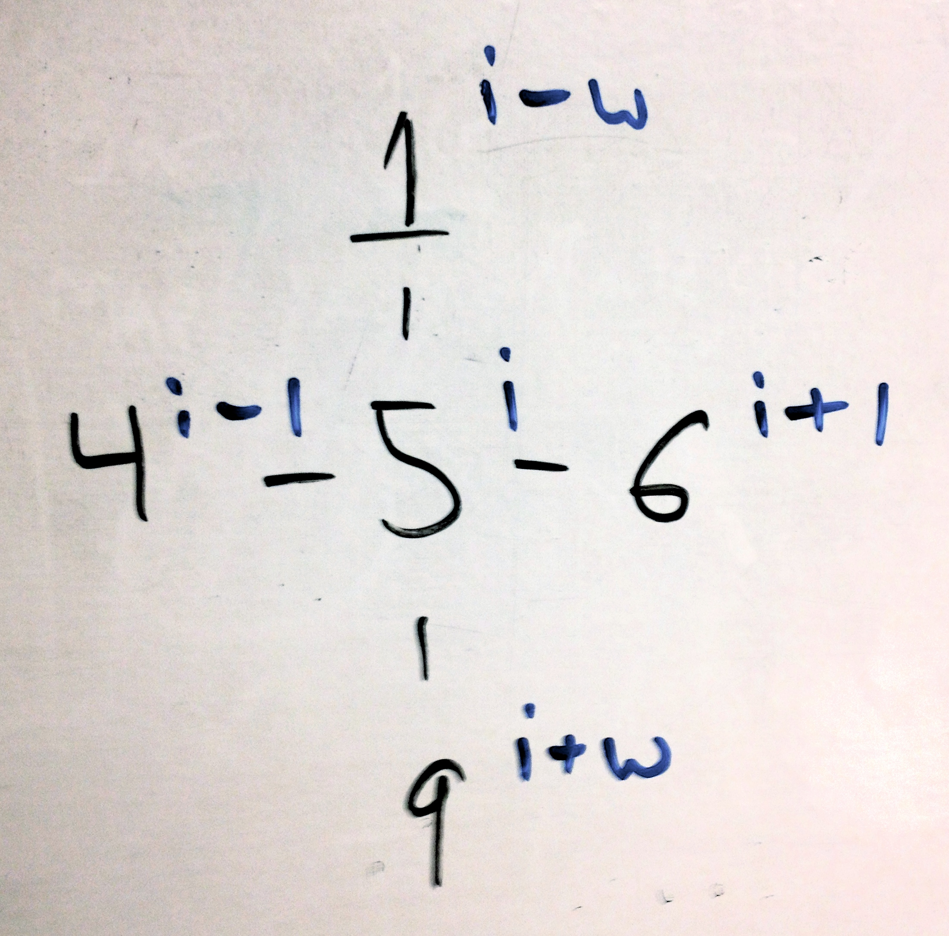
Homework 4
Checking for adjacency where w is the width and i is the index of your room. Make sure to not modify or jump over exterior walls.

Slide 21
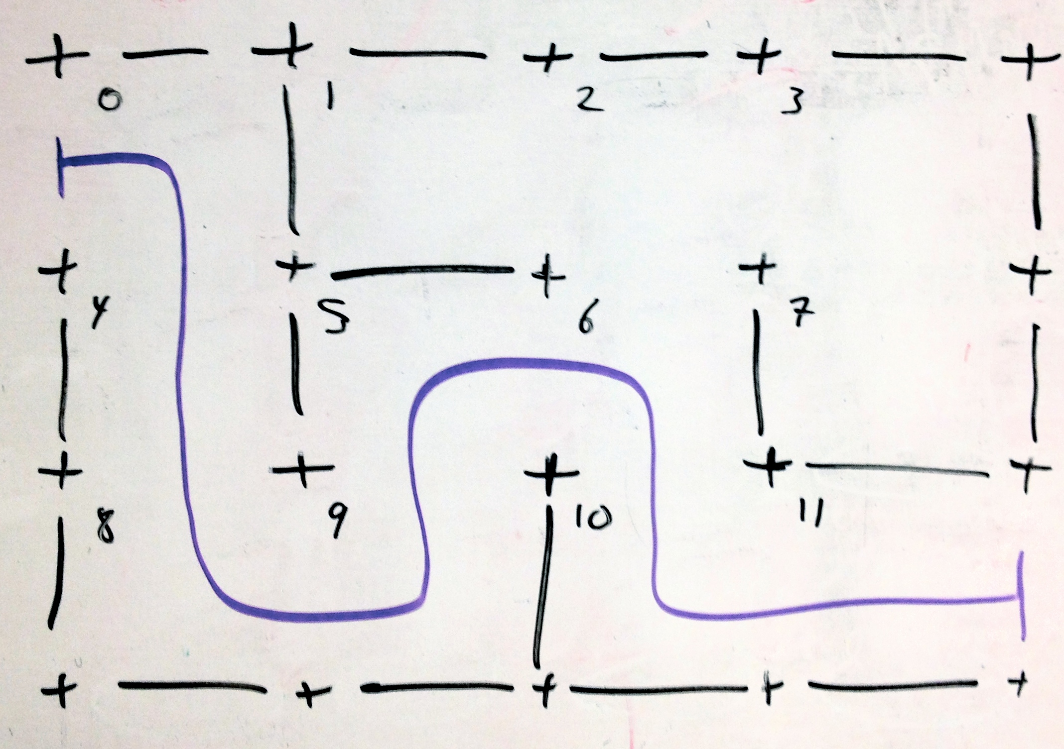
Homework 4
The solution is 0 4 8 9 5 6 10 11

Slide 22
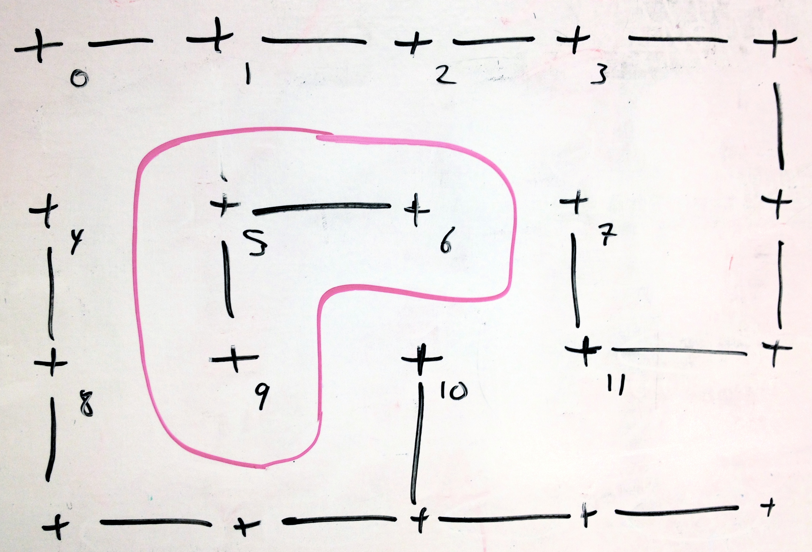
Homework 4
If you remove any interior wall there will be a cycle:

